Slide 1

Content, Assessment and Pedagogy
(CAP): An Integrated Design Approach
Instructional Team:
Ruth Streveler, Karl Smith & Rocío Chavela
2009 Workshop for
The Committee for the Formation of Engineers Puebla-Tlaxcala
Session 3 – July 2, 2009

Slide 2
Session 3 Overview
Welcome & Overview
Reflections and Session 3
  Participant “Think-Pair-Share” – Highlights, Insights, and Questions from Session 2
Pedagogy
  Planning Active and Cooperative Learning
Aligning Content, Assessment, and Pedagogy
Assignments & Next Steps

Slide 3

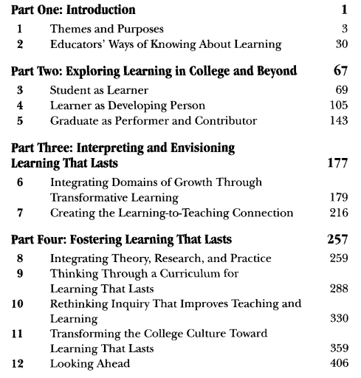
Resource: Learning that Lasts

Slide 4

Resource: Classroom Assessment Techniques
What classroom assessment entails and how it works.
How to plan, implement, and analyze assessment projects.
Twelve case studies that detail the real-life classroom experiences of teachers carrying out successful classroom assessment projects.
Fifty classroom assessment techniques
Step-by-step procedures for administering the techniques
Practical advice on how to analyze your data
http://honolulu.hawaii.edu/intranet/committees/FacDevCom/guidebk/teachtip/assess-2.htm
http://www.celt.iastate.edu/teaching/cat.html

Slide 5
Exercise 1
Three volunteers that would like to share one objective and get feedback from the instructional team

Slide 6
Exercise 2
Find a new partner (someone that is not so familiar with your course).
Share one learning objective and its assessment method(s)
Provide feedback to your partner

Slide 7
Think-Pair-Share about Session 2
Reflect on session 2. Briefly describe your major learning, insights, and questions.
Explain what you think is meant by:
  Pedagogies of Engagement – Active and Cooperative Learning
  Alignment of Content, Assessment and Pedagogy
Talk with other members of your group.

Slide 8

Lila M. Smith

Slide 9
Pedago-pathologies
Amnesia
Fantasia
Inertia
Lee Shulman – MSU Med School – PBL Approach (late 60s – early 70s); Stanford University, Past President of the Carnegie Foundation for the Advancement of College Teaching
Shulman, Lee S. 1999. Taking learning seriously. Change, 31 (4), 11-17.

Slide 10
What do we do about these pathologies? - Lee Shulman
Activity
Reflection
Collaboration
Passion
Shulman, Lee S. 1999. Taking learning seriously. Change, 31 (4), 11-17.

Slide 11
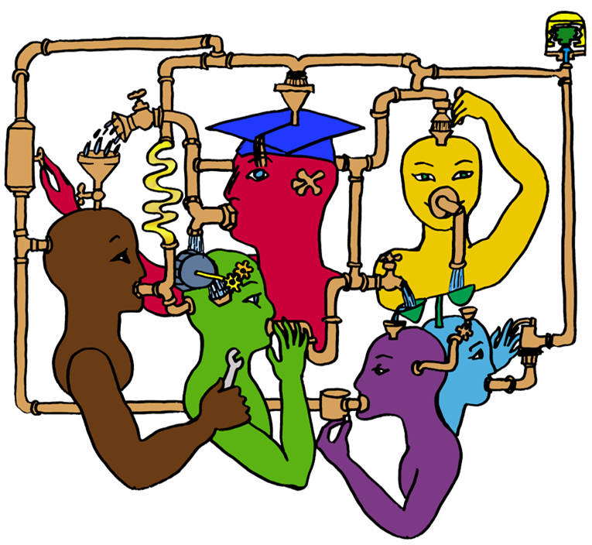

Slide 12
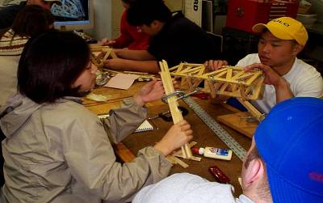
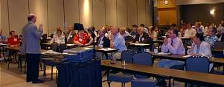
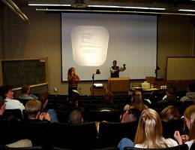
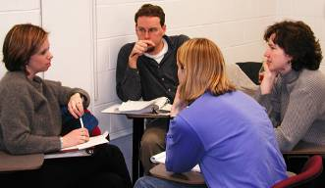
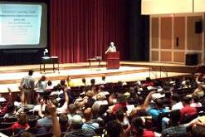
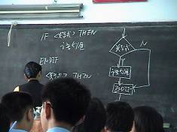
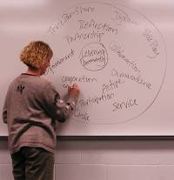
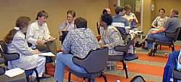
Pedagogies of Engagement

Slide 13
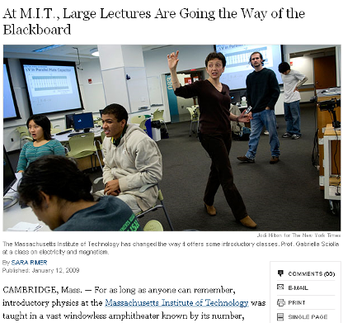
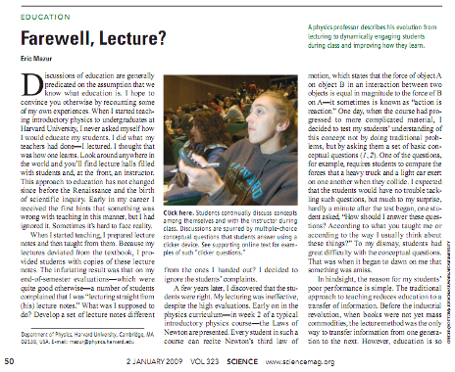
MIT & Harvard – Engaged Pedagogy
January 13, 2009—New York Times
http://www.nytimes.com/2009/01/13/us/13physics.html?em
January 2, 2009—Science, Vol. 323
www.sciencemag.org
Calls for evidence-based teaching practices

Slide 14
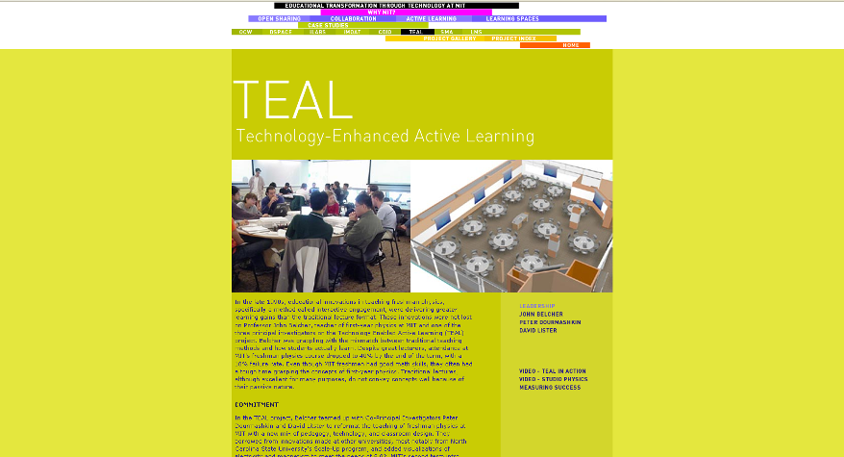
http://web.mit.edu/edtech/casestudies/teal.html#video

Slide 15
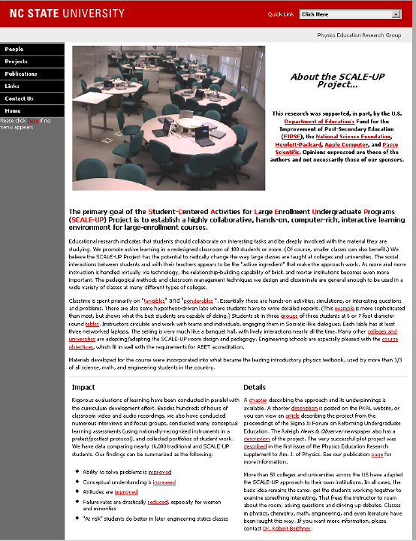
http://www.ncsu.edu/PER/scaleup.html

Slide 16
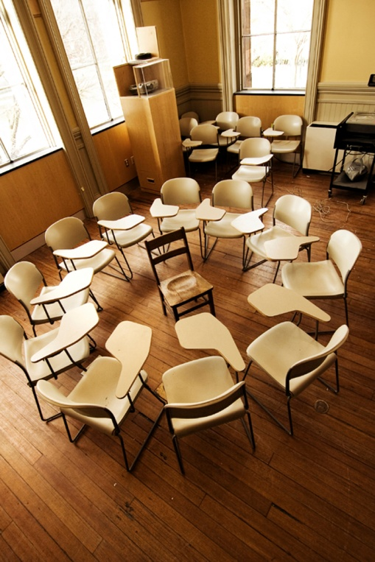
Cooperative Learning
Positive Interdependence
Individual and Group Accountability
Face-to-Face Promotive Interaction
Teamwork Skills
Group Processing

Slide 17
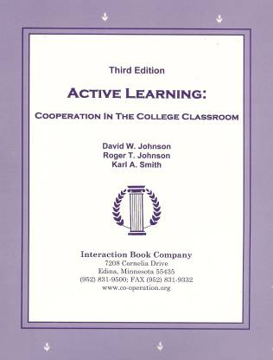

Cooperative Learning (cont.)

Slide 18


Cooperative Learning Research Support
Over 300 Experimental Studies
  First study conducted in 1924
  High Generalizability
  Multiple Outcomes
January 2005
March 2007
Johnson, D.W., Johnson, R.T., & Smith, K.A. 1998. Cooperative learning returns to college: What evidence is there that it works? Change, 30 (4), 26-35.

Slide 19
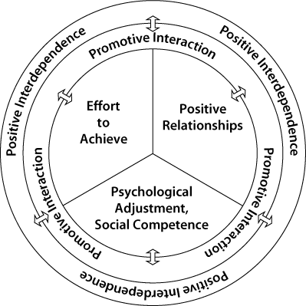
Outcomes
Achievement and retention
Critical thinking and higher-level
reasoning
Differentiated views of others
Accurate understanding of others' perspectives
Liking for classmates and teacher
Liking for subject areas
Teamwork skills

Slide 20
Faculty interest in higher levels of inquiry in engineering education
Level 0 Teacher
  Teach as taught
Level 1 Effective Teacher
  Teach using accepted teaching theories and practices
Level 2 Scholarly Teacher
  Assesses performance and makes improvements
Level 3 Scholar of Teaching and Learning
  Engages in educational experimentation, shares results
Level 4 Engineering Education Researcher
  Conducts educational research, publishes archival papers
Source: Streveler, R., Borrego, M. and Smith, K.A. 2007. Moving from the “Scholarship of Teaching and Learning” to “Educational Research:” An Example from Engineering. To Improve the Academy, Vol. 25, 139-149.

Slide 21
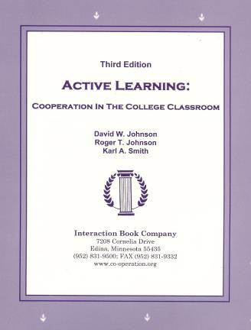
Active Learning: Cooperation in the College Classroom
Informal Cooperative Learning Groups
Formal Cooperative Learning Groups
Cooperative Base Groups
See Cooperative Learning
Handout (CL College-804.doc)

Slide 22
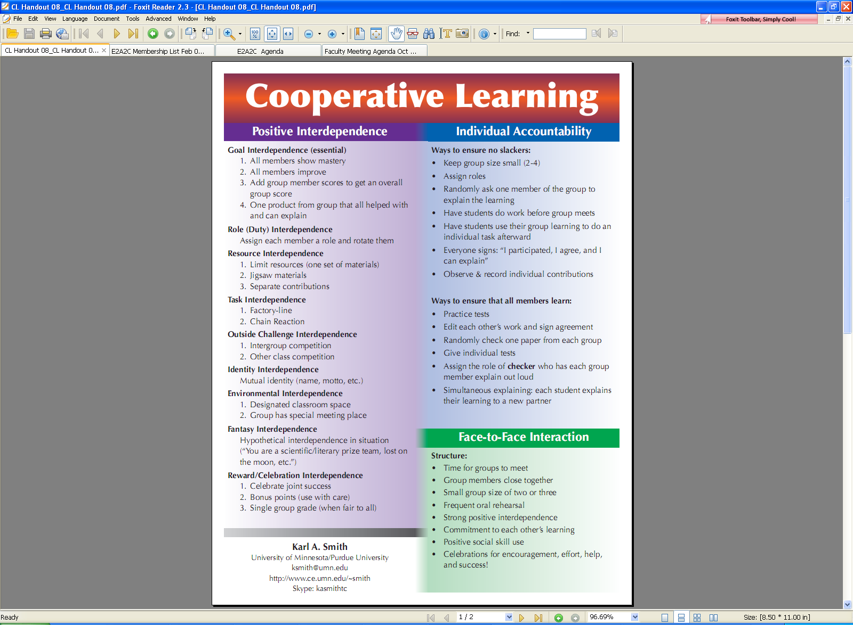
Cooperative Learning
People working in teams to accomplish a common goal
  Positive interdependence (all members must cooperate to complete the task)
  Individual and group accountability (each member is accountable for the complete final outcome)

Slide 23
Key Concepts
Positive Interdependence
Individual and Group Accountability
Face-to-Face Promotive Interaction
Teamwork Skills
Group Processing

Slide 24

Individual & Group Accountability

Slide 25
http://www.ce.umn.edu/~smith/docs/Smith-CL%20Handout%2008.pdf

Slide 26
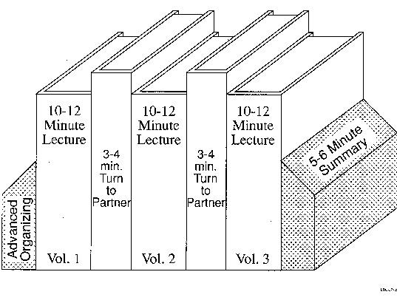
Book Ends on a Class Session

Slide 27
Advance Organizer
“The most important single factor influencing learning is what the learner already knows. Ascertain this and teach him accordingly.”
David Ausubel - Educational psychology: A cognitive approach, 1968.

Slide 28
Book Ends on a Class Session
Advance Organizer
Formulate-Share-Listen-Create (Turn-to-your-neighbor) -- repeated every 10-12 minutes
Session Summary (Minute Paper)
    What was the most useful or meaningful thing you learned during this session?
    What question(s) remain uppermost in your mind as we end this session?
    What was the “muddiest” point in this session?

Slide 29
Advance Organizer
“The most important single factor influencing learning is what the learner already knows. Ascertain this and teach him accordingly.”
David Ausubel - Educational psychology: A cognitive approach, 1968.

Slide 30
Quick Thinks
Reorder the steps
Paraphrase the idea
Correct the error
Support a statement
Select the response
Johnston, S. & Cooper,J. 1997. Quick thinks: Active- thinking in lecture classes and televised instruction. Cooperative learning and college teaching, 8(1), 2-7

Slide 31
Formulate-Share-Listen-Create
Informal Cooperative Learning Group
Introductory Pair Discussion of a
FOCUS QUESTION
Formulate your response to the question individually
Share your answer with a partner
Listen carefully to your partner's answer
Work together to create a new answer through discussion

Slide 32
Minute Paper
What was the most useful or meaningful thing you learned during this session?
What question(s) remain uppermost in your mind as we end this session?
What was the “muddiest” point in this session?
Give an example or application
Explain in your own words . . .
Angelo, T.A. & Cross, K.P. 1993. Classroom assessment techniques: A handbook for college teachers. San Francisco: Jossey Bass.

Slide 33
Session Summary (Minute Paper)
Reflect on the session
Most interesting, valuable, useful thing you learned.
Things that helped you learn.
Question, comments, suggestions.
Pace: Too slow 1 . . . . 5 Too fast
Relevance: Little 1 . . . 5 Lots
Instructional Format: Ugh 1 . . . 5 Ah

Slide 34
MOT 8221 – Spring 2009 – Session 1
Q4 – Pace: Too slow 1 . . . . 5 Too fast (3.3)
Q5 – Relevance: Little 1 . . . 5 Lots (4.2)
Q6 – Format: Ugh 1 . . . 5 Ah (4.4)

Slide 35
Informal CL (Book Ends on a Class Session) with Concept Tests
Physics
Peer Instruction
Eric Mazur - Harvard – http://galileo.harvard.edu
Peer Instruction – www.prenhall.com
Richard Hake – http://www.physics.indiana.edu/~hake/
Chemistry
Chemistry ConcepTests - UW Madison www.chem.wisc.edu/~concept
Video: Making Lectures Interactive with ConcepTests
ModularChem Consortium – http://mc2.cchem.berkeley.edu/

Slide 36

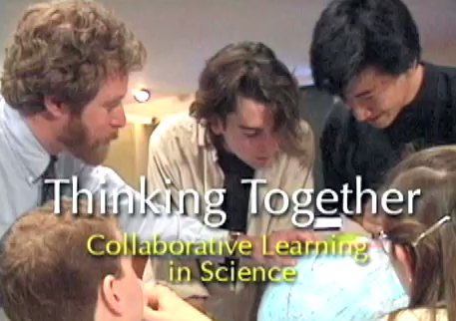
Informal CL (Book Ends on a Class Session) with Concept Tests
STEMTEC
Video: How Change Happens: Breaking the “Teach as You Were Taught” Cycle – Films for the Humanities & Sciences – www.films.com
Harvard
Thinking Together & From Questions to Concepts Interactive Teaching in Physics: Derek Bok Center – www.fas.harvard.edu/~bok_cen/

Slide 37
<g> = Concept Inventory Gain/Total

Slide 39
The “Hake” Plot of FCI
35.00
SDI
30.00
UMn-CL+PS
ALS
X
WP
25.00
UMn Cooperative Groups
X
20.00
PI(HU)
15.00
UMn Traditional
ASU(nc)
10.00
WP*
ASU(c)
HU
5.00
0.00
20.00
30.00
40.00
50.00
60.00
70.00
80.00
Pretest (Percent)

Slide 40
Physics (Mechanics) Concepts:
The Force Concept Inventory (FCI)
A 30 item multiple choice test to probe student's understanding of basic concepts in mechanics.
The choice of topics is based on careful thought about what the fundamental issues and concepts are in Newtonian dynamics.
Uses common speech rather than cueing specific physics principles.
The distractors (wrong answers) are
based on students' common inferences.

Slide 41
Informal Cooperative Learning Groups
Can be used at any time
Can be short term and ad hoc
May be used to break up a long lecture
Provides an opportunity for students to process material they have been listening to (Cognitive Rehearsal)
Are especially effective in large lectures
Include "book ends" procedure
Are not as effective as Formal Cooperative Learning or Cooperative Base Groups

Slide 42
Active Learning: Cooperation in the College Classroom
Informal Cooperative Learning Groups
Formal Cooperative Learning Groups
Cooperative Base Groups
See Cooperative Learning
Handout (CL College-804.doc)

Slide 43

Formal Cooperative Learning Task Groups

Slide 44

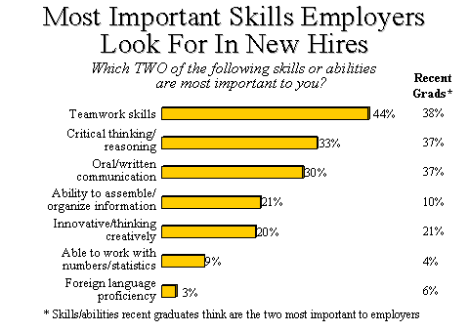
http://www.aacu.org/advocacy/leap/documents/Re8097abcombined.pdf

Slide 45

Top Three Main Engineering Work Activities
Engineering Total
Design – 36%
Computer applications – 31%
Management – 29%
Civil/Architectural
Management – 45%
Design – 39%
Computer applications – 20%
Burton, L., Parker, L, & LeBold, W. 1998. U.S. engineering career trends. ASEE Prism, 7(9), 18-21.

Slide 46
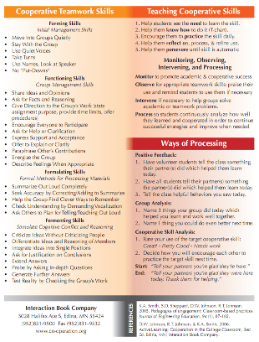
Teamwork Skills
Communication
  Listening and Persuading
Decision Making
Conflict Management
Leadership
Trust and Loyalty

Slide 47
Teamwork Skills
Design team failure is usually due to failed team dynamics
(Leifer, Koseff & Lenshow, 1995).
It’s the soft stuff that’s hard, the hard stuff is easy
(Doug Wilde, quoted in Leifer, 1997)
Professional Skills
(Shuman, L., Besterfield-Sacre, M., and McGourty, J., “The
ABET Professional Skills-Can They Be Taught? Can They Be Assessed?” Journal of Engineering Education, Vo. 94, No. 1, 2005, pp. 41–55.)

Slide 48
Teamwork

Slide 49
Characteristics of Effective Teams

Slide 50

Characteristics of Effective Teams
A small number of people with complementary skills who are committed to a common purpose, performance goals, and approach for which they hold themselves mutually accountable
SMALL NUMBER
COMPLEMENTARY SKILLS
COMMON PURPOSE & PERFORMANCE GOALS
COMMON APPROACH
MUTUAL ACCOUNTABILITY
--Katzenbach & Smith (1993) The Wisdom of Teams

Slide 51

Hackman – Leading Teams
Real Team
Compelling Direction
Enabling Structure
Supportive Organizational Context
Available Expert Coaching
Team Diagnostic Survey (TDS)
https://research.wjh.harvard.edu/TDS/

Slide 52
Professor's Role in
Formal Cooperative Learning
Specifying Objectives
Making Decisions
Explaining Task, Positive Interdependence, and Individual Accountability
Monitoring and Intervening to Teach Skills
Evaluating Students' Achievement and Group Effectiveness

Slide 53
Formal Cooperative Learning
Types of Tasks
Jigsaw – Learning new conceptual/procedural material
Peer Composition or Editing
Reading Comprehension/Interpretation
Problem Solving, Project, or Presentation
Review/Correct Homework
Constructive Academic Controversy
Group Tests

Slide 54
Challenged-Based Learning
Problem-based learning
Case-based learning
Project-based learning
Learning by design
Inquiry learning
Anchored instruction
John Bransford, Nancy Vye and Helen Bateman. Creating High-Quality Learning Environments: Guidelines from Research on How People Learn

Slide 55
Challenge-Based Instruction with the Legacy Cycle
The Challenges
Go Public
Generate Ideas
Legacy
Cycle
Test Your Mettle
Multiple Perspectives
Research & Revise
https://repo.vanth.org/portal/public-content/star-legacy-cycle/star-legacy-cycle

Slide 56
Kolb’s Experiential Learning Cycle
Concrete
Experience
Observation and Reflections
Formulation of abstract concepts and generalizations
Testing implications of concepts in new situations

Slide 57

5 E Learning Cycle Model
Engage
Explore
Explain
Elaborate
Evaluate
http://faculty.mwsu.edu/west/maryann.coe/coe/inquire/inquiry.htm

Slide 58

Problem-Based Learning
Problem Posed
Identify what we need to know
Learn it
Apply it
START

Slide 59
Problem Based
Cooperative Learning Format
TASK: Solve the problem(s) or Complete the project.
INDIVIDUAL: Estimate answer. Note strategy.
COOPERATIVE: One set of answers from the group, strive for agreement, make sure everyone is able to explain the strategies used to solve each problem.
EXPECTED CRITERIA FOR SUCCESS: Everyone must be able to explain the strategies used to solve each problem.
EVALUATION: Best answer within available resources or constraints

Slide 60
Problem Based
Cooperative Learning Format
INDIVIDUAL ACCOUNTABILITY: One member from your group may be randomly chosen to explain (a) the answer and (b) how to solve each problem.
EXPECTED BEHAVIORS: Active participating, checking, encouraging, and elaborating by all members.
INTERGROUP COOPERATION: Whenever it is helpful, check procedures, answers, and strategies with another group.

Slide 61
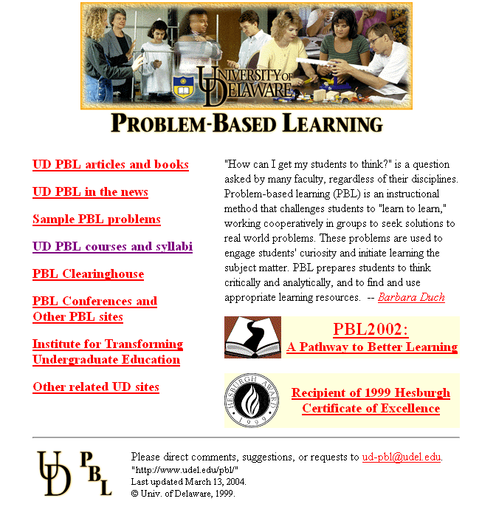
http://www.udel.edu/pbl/

Slide 62
Cooperative Base Groups
Are Heterogeneous
Are Long Term (at least one quarter or semester)
Are Small (3-5 members)
Are for support
May meet at the beginning of each session or may meet between sessions
Review for quizzes, tests, etc. together
Share resources, references, etc. for individual projects
Provide a means for covering for absentees

Slide 63
Exercise
What kind of learning environments will produce the outcomes you are assessing?
Complete your worksheet using the questions on the next page.

Slide 64
Backward Design
Plan Learning Experiences & Instruction
What enabling knowledge (facts, concepts, and principles) and skills (procedures) will students need to perform effectively and achieve desired results?
What activities will equip students with the needed knowledge and skills?
What will need to be taught and coached, and how should it be taught, in light of performance goals?
What materials and resources are best suited to accomplish these goals?
Is the overall design coherent and effective?
CAP - 64

Slide 65
Worksheet for Designing a Course/Class Session/Learning Module
 | Ways of Assessing | Actual Teaching-Learning | Helpful Resources:
Learning Goals for Course/Session/Learning Module: | This Kind of Learning: | Activities: | (e.g., people, things)
1.
2.
3.
4.
5.
6.

Slide 66
Next Steps
What questions do you still have about the next steps?
What information do you need to explain your plan into a year-long project?

